Slide 1

One Person's Culture is Another's Crime: The Question of the Cultural Defense
Yoram Rabin & Yaniv Vaki
MAD colloquium series on migration studies
Berlin, June 12, 2024

Slide 2
The clash between (some) cultural customs and the Law
General: influence of cultural traditions on behavior.
The clash: heritage, traditions, and customs of immigrants to Western countries often clash with the law and constitute crimes.
The dilemma in criminal law: The clash with the law raises the question of criminal law and the “cultural defense”.

Slide 3
People v. Kimura (1985)
The facts
Fumico Kimura was a Japanese-American woman.
She attempt to drown herself with her children.
The children drowned.
She charged with first degree murder.

Slide 4
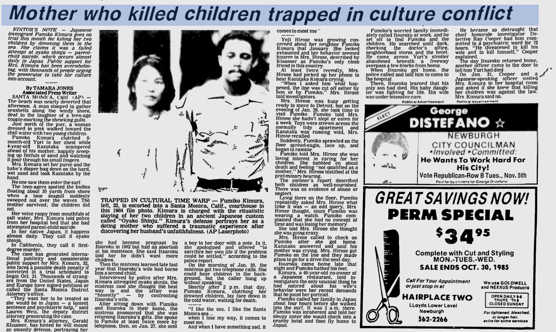

Slide 5
People v. Kimura (1985)
The Japanese culture that played a role in the case
Oya-ko shinju (parent-child suicide).
perceptions of motherhood in the Japanese tradition.
Japanese attitudes toward suicide.

Slide 6
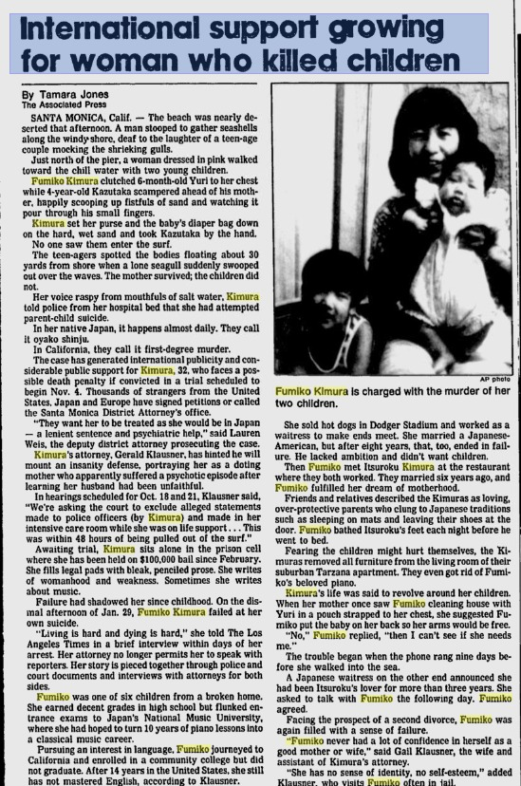
People v. Kimura (1985)
Trial and Result
Community support and petition to the district attorney.
Charges reduced to involuntary manslaughter.
the court expressly considered the punishment she would have received in Japan.
Final sentencing: five years of probation and one year in the county jail.

Slide 7
People v. Kimura (1985)
Scholars differ on the extent to which Kimura's cultural background played a role in the court and influenced the outcome of the trial.
Kimura's case sparked off the long debate about cultural defense.
The first article that drew attention to the claim, using the term "cultural defense" for the first time, was the following: Note, The Cultural Defense in the Criminal Law, 99 Harvard Law Review 1293 (1986).

Slide 8
What is Cultural Defense?
Definition by Norgren and Nanda:
“A Cultural defense holds that persons socialized in a minority or foreign culture who regularly conduct themselves in accordance with their own culture’s norms, should not be held fully accountable for conduct that violates official […] law, if these individuals’ conduct conforms to the prescription of their own culture.
The intention of a cultural defense in a criminal case is to negate or mitigate criminal responsibility where acts are committed under a reasonable, good-faith belief in their propriety based upon the actor’s heritage or tradition.”

Slide 9
Arguments for and against cultural defense
Culpability and moral responsibility
It may be justified not to punish an accused if the offense committed was permissible under the entrenched social concepts of the perpetrator, which reduces the degree of culpability.
The low level of culpability stems from the fact that the accused committed the acts believing that the actions were desirable, even necessary under a given religious or traditional imperative.

Slide 10
Arguments for and against cultural defense
Criminal law is the last defense of minimum liberal values
criminal law reflects the level of tolerance in society, therefore consideration of non-liberal cultures or anti-social acts is undesirable and may harm the social fabric and protected values.

Slide 11
Arguments for and against cultural defense
Criminal law is the last defense of minimum liberal values
Israeli Supreme Court Justice, Salim Joubran:
“Before recognizing the accused's right to culture, the victim's right to life and bodily integrity must be protected. Tolerance in a multicultural society has limits. These limits are determined by balancing the principles of multiculturalism with that of liberalism [...] It is understood that in this balance, violent customs, such as blood revenge, honor killing, etc., fall outside the multicultural arena. There is no possibility of accepting a cultural custom that follows a path of severe violence. We must fight a bitter war against violent customs of this type. We are committed to maintaining basic moral standards, first and foremost, the sanctity of life and the integrity of the body. A cultural custom that violates these fundamental values is not acceptable in a liberal, multicultural society.”
C.A. 10358/08 Azbarga v. State of Israel (March 16, 2010)

Slide 12
Arguments for and against cultural defense
Ignorance of the law does not exempt from punishment
“ignorance of the law is no excuse.”
The applicability of criminal law is not subjective and does not reflect the defendant's worldview.
The adoption of the cultural defense may lead to unjustified inequality between defendants.

Slide 13
Arguments for and against cultural defense
Feminist theories
Attempt to justify harming women and children.
Normalization of harmful practices
Undermining legal protections.

Slide 14
Arguments for and against cultural defense
Feminist theories
Doriane Colman:
“What happens to the victims – almost always minority women and children – when multiculturalism and individualized justice are advanced by dipositive cultural evidence? The answer, both in theory and in practice, is stark: they are denied the protection of the criminal laws because their attackers generally go free, either immediately or within a relatively brief period of time.”
Doriane Lambelet Coleman, Individualizing Justice Through Multiculturalism: The Liberals’ Dilemma, 96 Columbia Law Review 1093 (1996).

Slide 15
Models of Cultural Defense
The three models:
Independent criminal defense.
Integration of cultural arguments within existing defenses.
Cultural background as a mitigating factor in sentencing.

Slide 16
Model I: Independent Cultural Defense
Full acquittal.
Culture can reduce the degree of the culpability.
But… it does not fully exculpate the defendant.

Slide 17
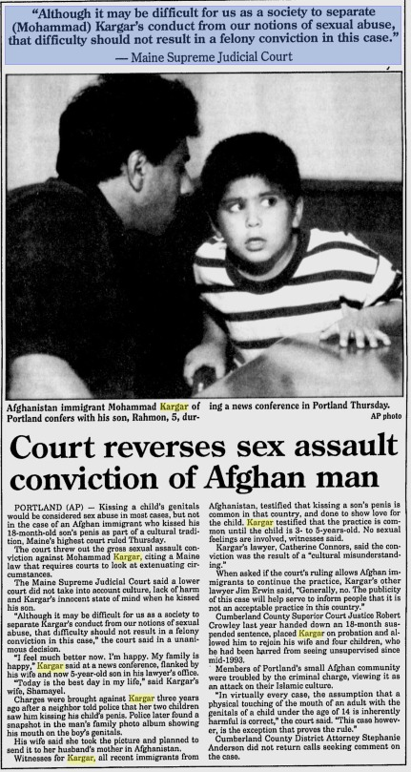
Model II: Integration of cultural arguments within existing defenses
Moderate model: Integration of cultural arguments within existing defenses.
Example: Kargar case
    Facts
    The cultural arguments
    The court in Maine
    Supreme Judicial Court of Maine

Slide 18
Model III: Cultural background as a mitigating factor in sentencing
Sentencing considerations.
Degree of culpability.

Slide 19
Conclusion
Recognizing an independent cultural defense in criminal law is not justified.
When successfully raised, the defense can use cultural evidence to either establish an affirmative criminal defense or support a more lenient sentence.
Thank you !

